Slide 1
Dissertation Figures

Slide 2
Cancer Treatment
Tumor Development
Patient Characteristics
DNA Damage
Structural Damage
Compromised Neurotransmission
Impaired Neurogenesis
Types of Damage
Impaired Executive Control
Diminished Working Memory
Attention Deficits
Cancer-Related Cognitive Decline

Slide 3
Cancer Treatment
Tumor Development
Patient Characteristics
INFLAMMATION
DNA Damage
Structural Damage
Compromised Neurotransmission
Impaired Neurogenesis
Types of Damage
Impaired Executive Control
Diminished Working Memory
Attention Deficits
Cancer-Related Cognitive Decline

Slide 4
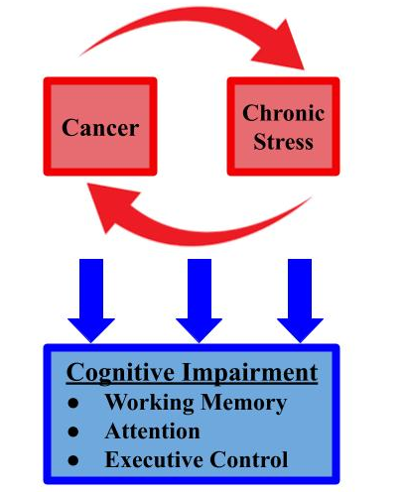

Slide 5
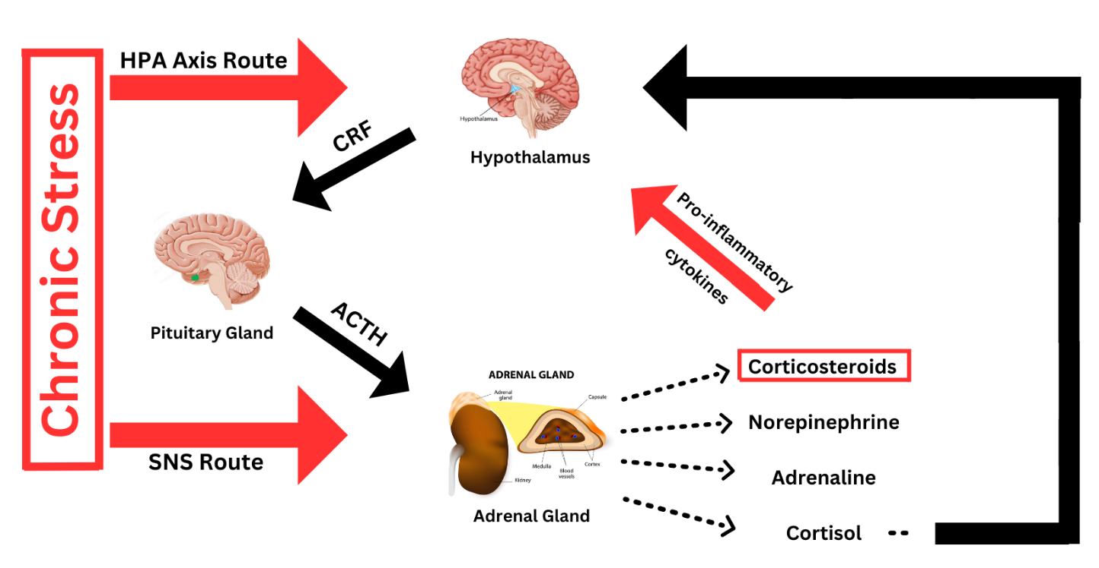
Hypothalamus
Pituitary Gland
Adrenal Gland

Slide 6
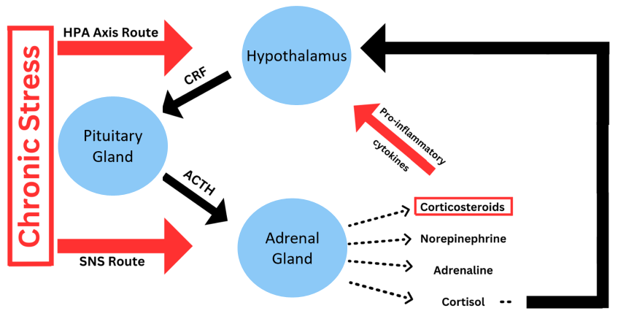

Slide 7
